Slide 1
Scratchbook: hide before presenting
Hey! Ich schlage die folgende Arbeitsverteilung vor: Ardeshir, Lyubomira, Yordan
A: “Hello” and a VERY SHORT introduction to the project (2 min max) - use old slides to facilitate people's memory
A: Flink windowing 101 (3 min) - talk about different kinds of windows, how, when and why to window, in a dummy-friendly manner
Y: LPC Durbin windowing (2 min) - talk about and give examples of how we have used windowing in our implementation. Talk about possible alternatives. Give a graphic presentation (animation would be nice)
L: Flink operations 101 (3 min) - talk about different kinds of function you can perform on windowed streams. Draw comparisons to non-windowed streams
Y: LPC Durbin implementation (4 min) talk about how we have implemented the LPC Durbin. How data gets in and out of our function. Advantages and Disadvantages of our method. How we read and write data. Other possible solutions. Don’t show more than 3 lines of code at a time.
L: Future developments (1 min) Talk about streaming audio, karaoke, speech recognition.
Sum: 15 min.

Slide 2
Distributed Streaming Processing
3rd. Milestone
A. S. Nejad | L. Gerova | Y. Grigorov

Slide 3
Agenda
Recap
Flink windowing
Flink operations
Our implementation
Future developments
Notes:
We dont need the intro in the summary

Slide 4
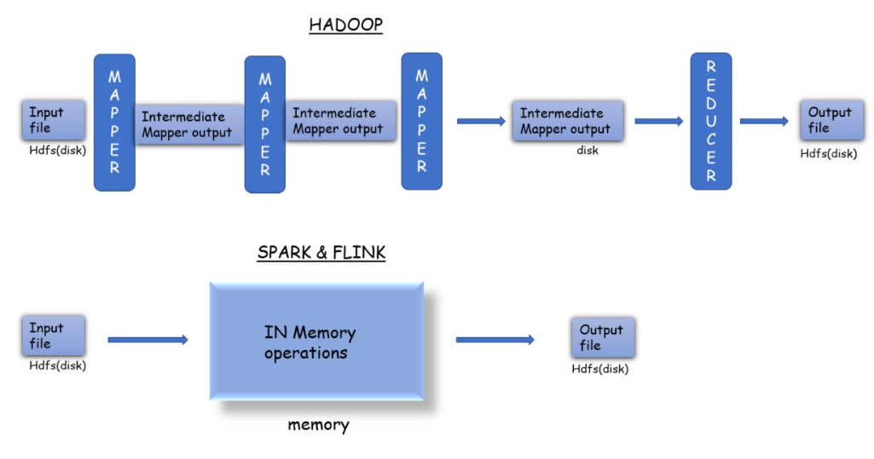
Motivation: From Batch to Stream Processing
1st MS

Slide 5
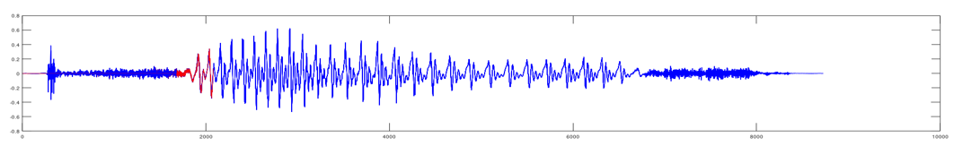
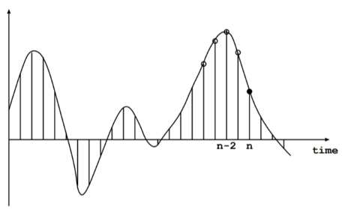
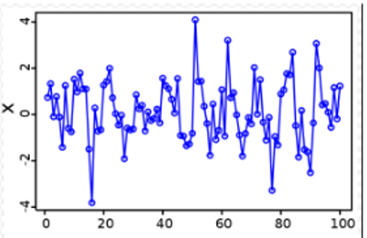
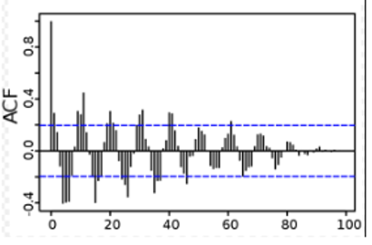
Challenge: Digital Signal Processing with Flink
2nd MS

Slide 6
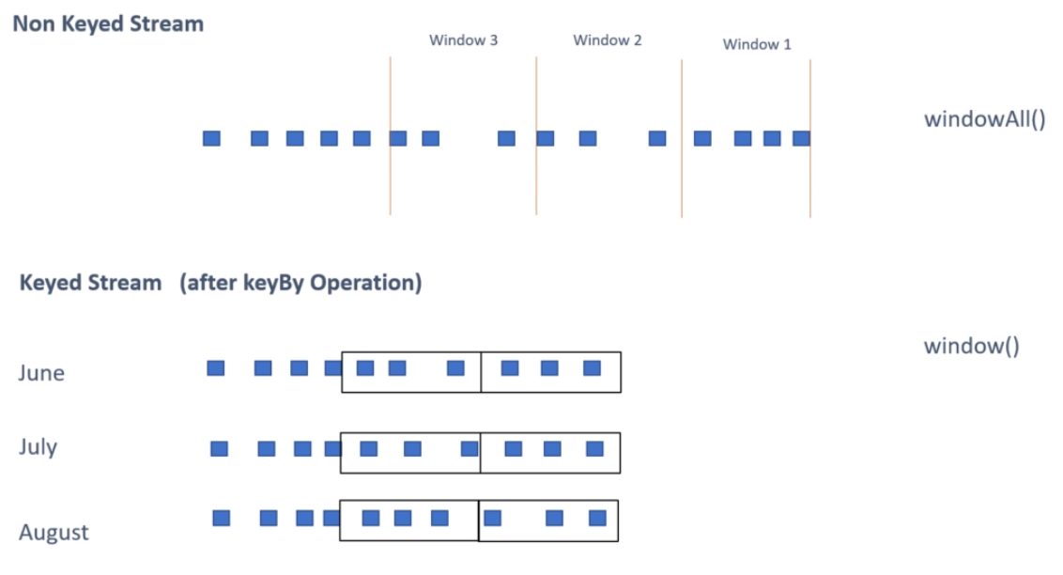
Window Concept
3rd MS

Slide 7
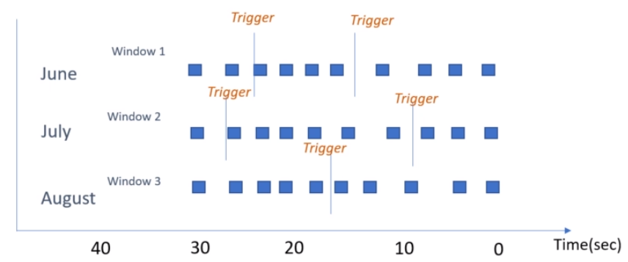
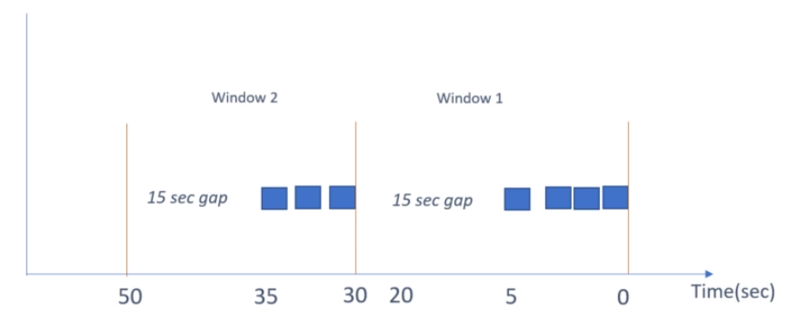
Session & Global Windows

Slide 8
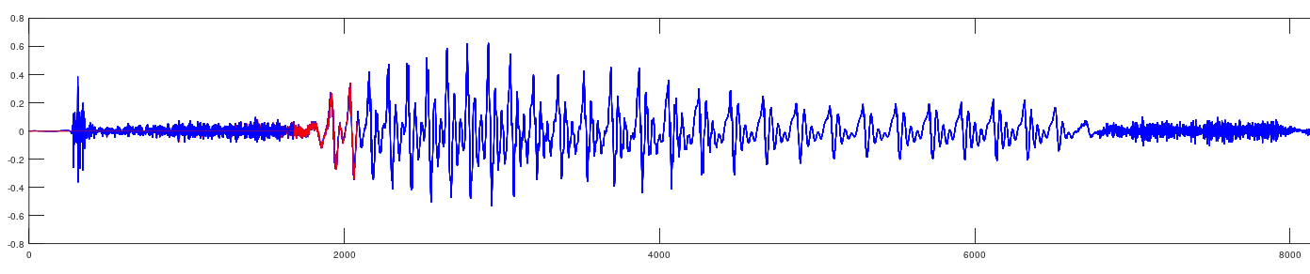
Tumbling & Sliding Windows
Sliding
Tumbling

Slide 9

Y: LPC Durbin windowing
16kH = 16 000 samples/sec
~100 windows for 0.5 recording
80 samples
400 samples
Notes:
Window Selection should be uniform
Small windows
Each window produces 1 coefficient

Slide 10
Operations: Non-windowed streams
FILTER
(FLAT)MAP
:1
:1
:1
:1
Notes:
When working with non-windowed stream, Flink offers all functions we’d need, for example filter, map or flatmap, …..,

Slide 11
Operations: Non-windowed streams
FILTER
(FLAT)MAP
:1
:1
:1
:1
:2
Fold, sum, min, max
:1
:1
:1
:1
REDUCE
:2
Notes:
As well as the reduce function, fold, sum, min and max

Slide 12
Operations: Windowed Streams
Same functions as before…
apply(): a custom function
Plain old java function
Notes:
On windowed streams you can use the same functions as for non-windowed streams, but also we can use one important function - apply. When using apply, it is expected from us to write what we want to happen with information from the window. It is written in almost the same way as a java function, where you have an input and an output. V zavisimost ot window-a, moje da izberem da outputnem kolkoto iskame elementi. Ne e zaduljitelno za vseki element v streama da prisustva tochno edin output element.

Slide 13
Operations: Windowed Streams
Same functions as before…
apply(): a custom function
Plain old java function
Notes:
Or as few as you want.

Slide 14
Operations: Windowed Streams
Same functions as before…
apply(): a custom function
Plain old java function
Notes:
Or even none at all.

Slide 15
Y: LPC Durbin implementation
//Read audio:
.window(...)
.apply(new LPC(...));
//Write coefficients to file

Slide 16
LPC function:
Preemphasis
Hamming
Autocorrelation
Durbin
Additional params

Slide 17
Optimization:
2 Types of parallelism:
Partitioned
Pipelined

Slide 18
Another way:
.window(...)
.apply(new preEmph(...));
.apply(new hamming(...))
.apply(new durbin())
Our way:
//Read audio:
.window(...)
.apply(new LPC(...));

Slide 19
Overview of our pipeline
Keyed
FILTER
(red)
WRITE()
...
READ()
WINDOW()
LPC()
FILTER
(blue)
WRITE()
FILTER
(yellow)
WRITE()

Slide 20

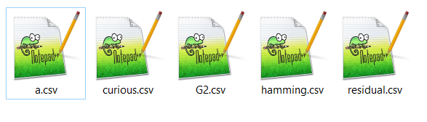
Another overview...

Slide 21
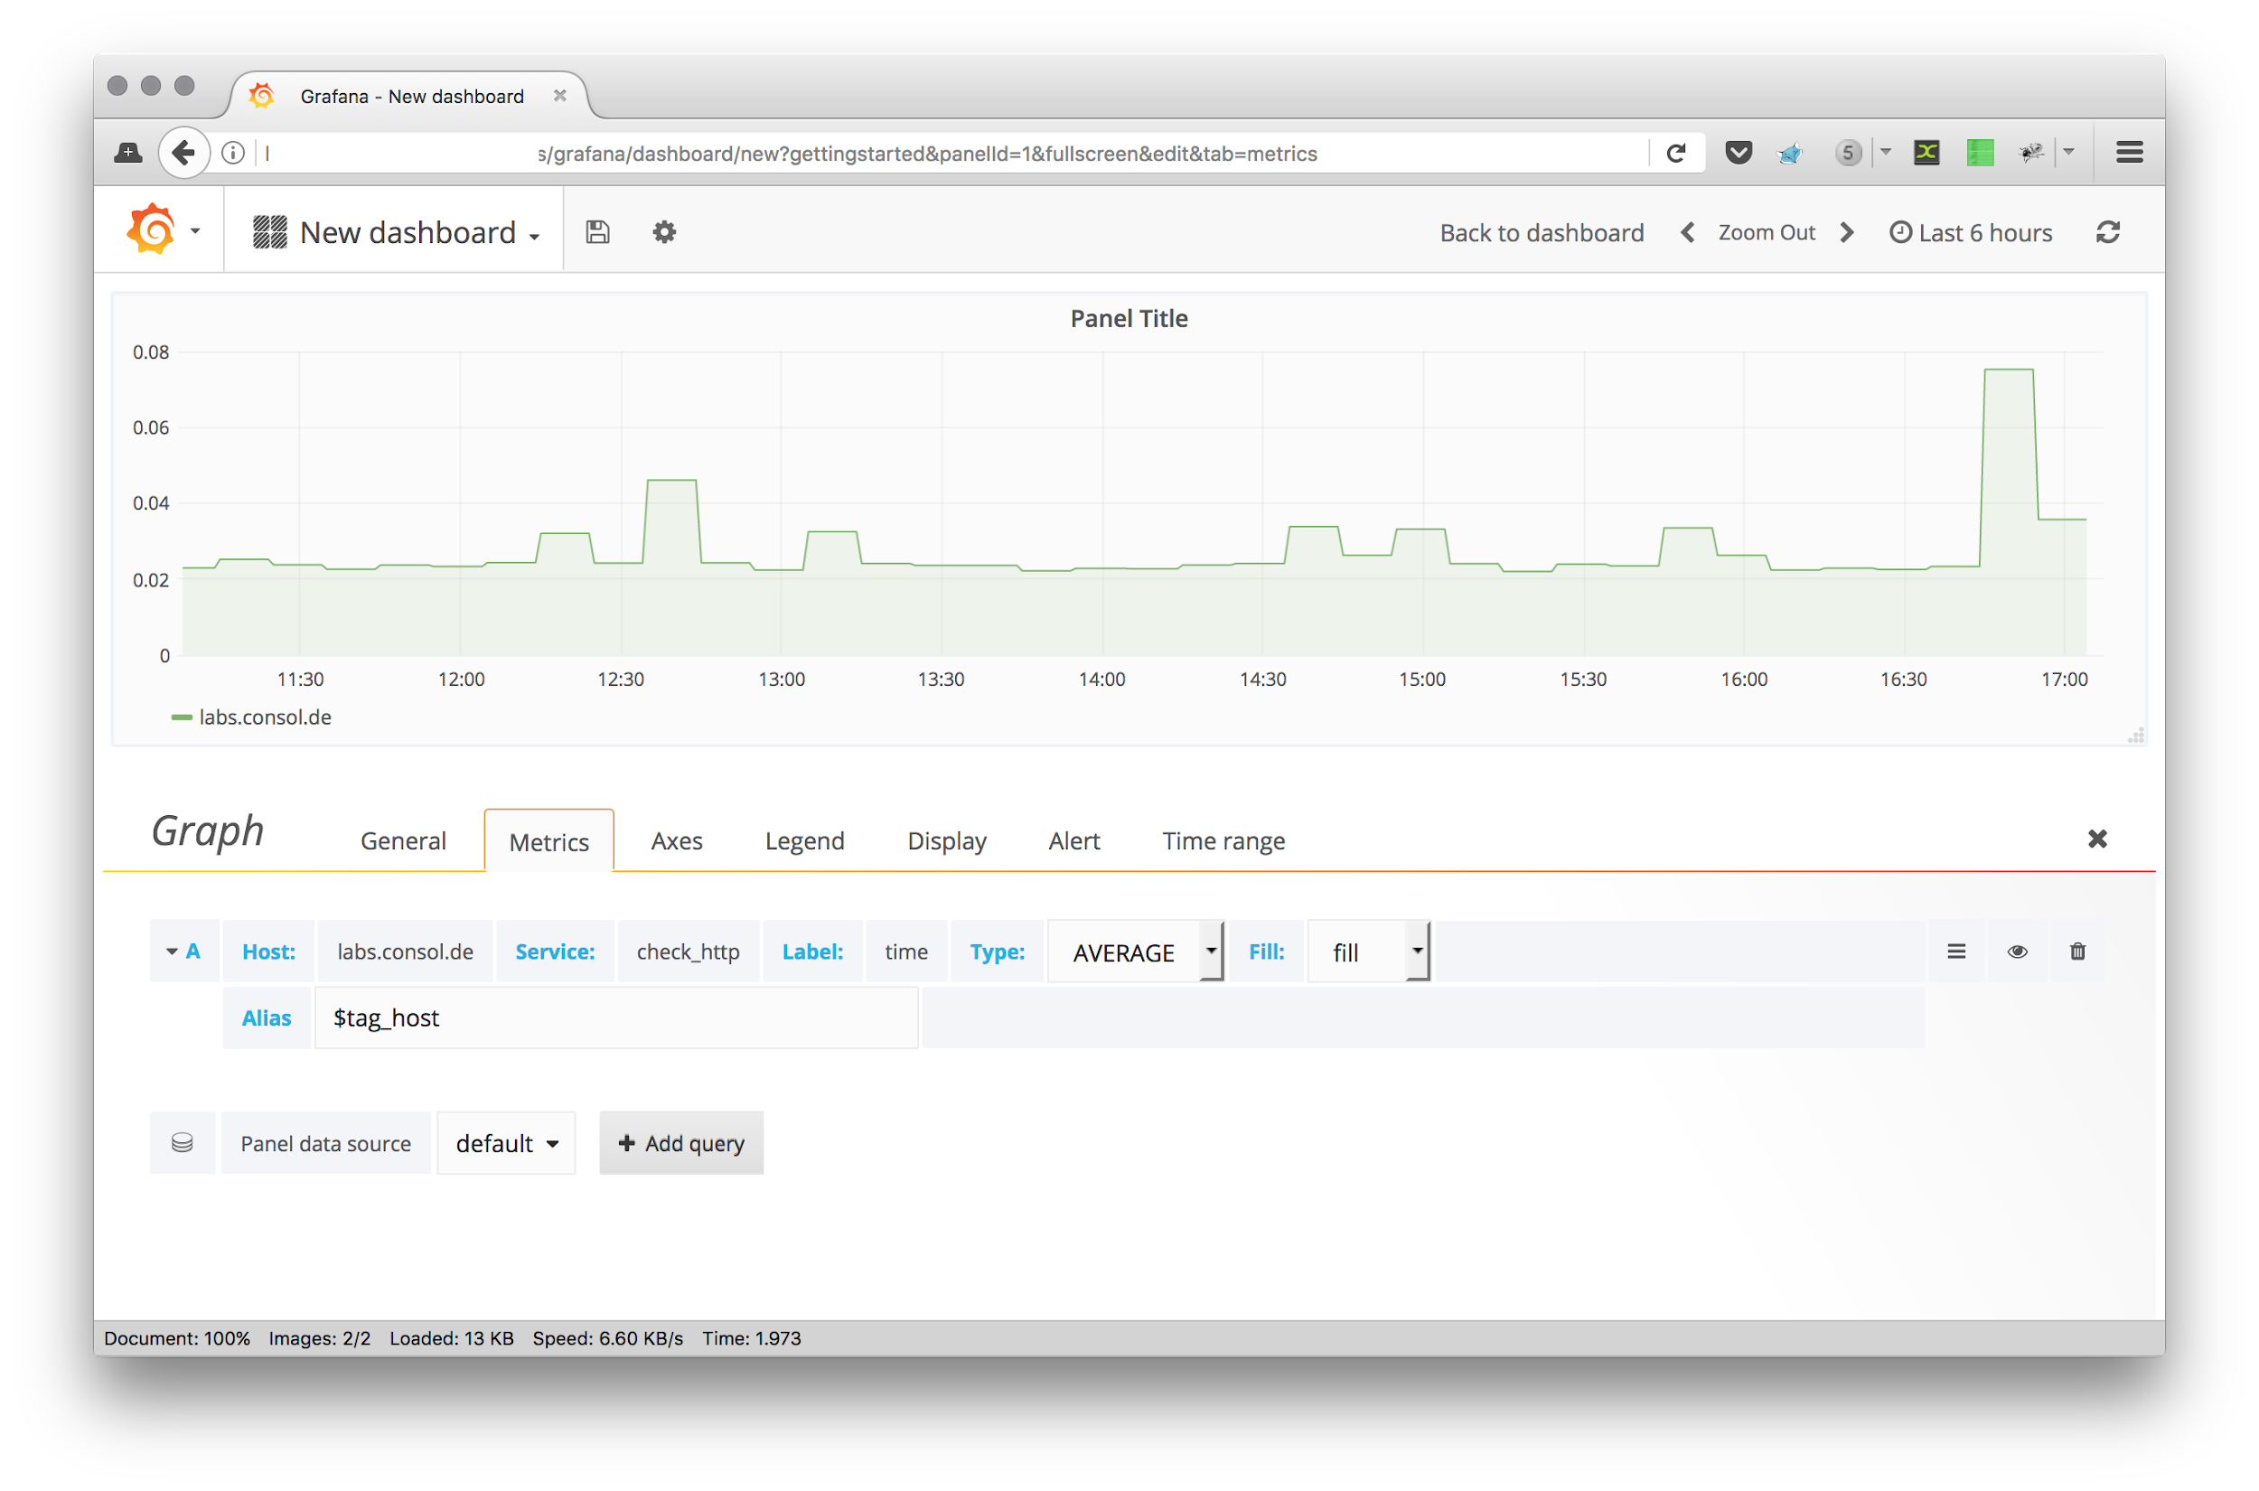
Future development: Visualize with Grafana
Notes:
One way to expand what we have done is to hook up Flink with Grafana to give our results a nice visualization.

Slide 22

Future development: Take audio from mic
Notes:
Another way to expand would be to take the audio data from a live microphone input.

Slide 23

Future development: Take audio from Internet
Notes:
Or we could connect to the internet and analyze audio from there.

Slide 24
Future development: Speech recognition
“Hello.”
Notes:
The LPC algorithm can be used to recognize speech

Slide 25




Future development: Machine learning
?
“Hello.”
Sentiment analysis
Ease of access
Make sense of the world
Notes:
A way to really showcase what you can do armed with Flink and the LPC algorithm, would be to connect the speech recognition to some machine learning algorithm. From there you could assess the sentiment of a given piece or at a larger scale you could be processing so much incoming live audio from sources all around the world which would enable you to make sense of what people talk about, and what drives the world today.

Slide 26
Summary
Flink windowing
Flink operations
Our implementation
Future developments

Slide 27
Backup Slides

